Slide 1

Diagnosis of Pneumonia from Chest X-ray using Deep Learning

Slide 2
Submitted By: Joy Das Shanta Id : 1402610200644 Tasfia Azim Id : 1402610200668 | Submitted To: Faisal Ahmed Lecturer Department of Computer Science & Engineering Premier University, Chittagong

Slide 3
Contents :
1. Motivation
2. Objectives
3. Features of Pneumonia Disease
4. Related Works
5. Model Selection
6. Model Summary
7. Experimental Analysis
1. Dataset
2. Platform
3. Model Selection
4. Model Validation

Slide 4
Contents :
10. Why choose this
11. Several Input Shape
12. Our Shape Summary
14. Future Work
15. Question Part

Slide 5
Motivation :
In Bangladesh,
Pneumonia is responsible for around 28% of the deaths of children under five years of age.
Around 50,000 children die of pneumonia every year.
Total number of infections is likely to be much higher.
Bangladesh has one doctor for every 1847 people. We do not have enough manpower to treat many people at a time. We want to develop a computerized system to detect disease faster and more humanlike.
Source : International Centre for Diarrhoeal Disease Research, Bangladesh

Slide 6
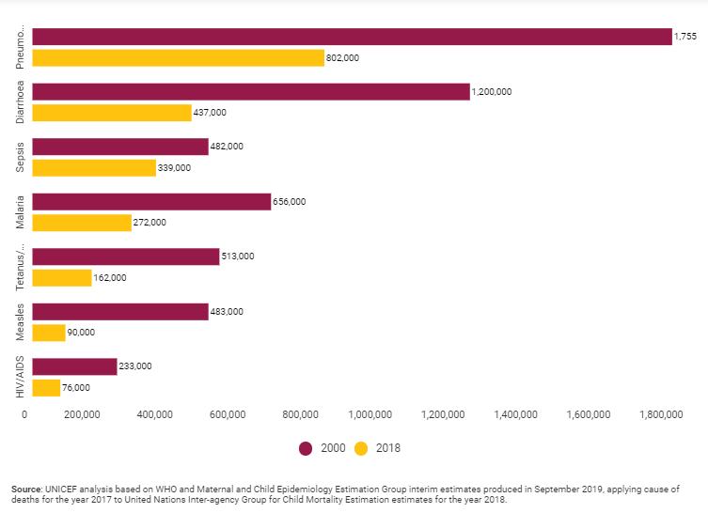
Motivation :

Slide 7
Objectives :
To build an efficient CNN model for detecting Pneumonia disease accurately using CNN from the Perspective of Bangladesh.
To develop a computerized system so that detection gets much easier.
To construct a system that can diagnose Pneumonia more like human experts(doctors, radiologists).
To create a system with less computational resources.

Slide 8
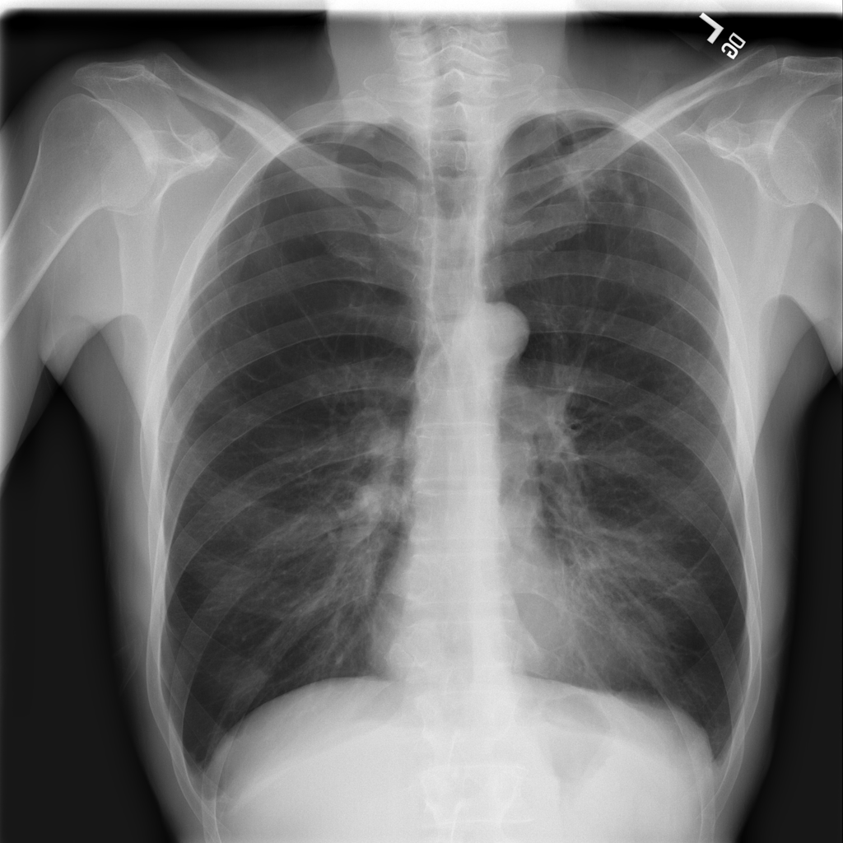
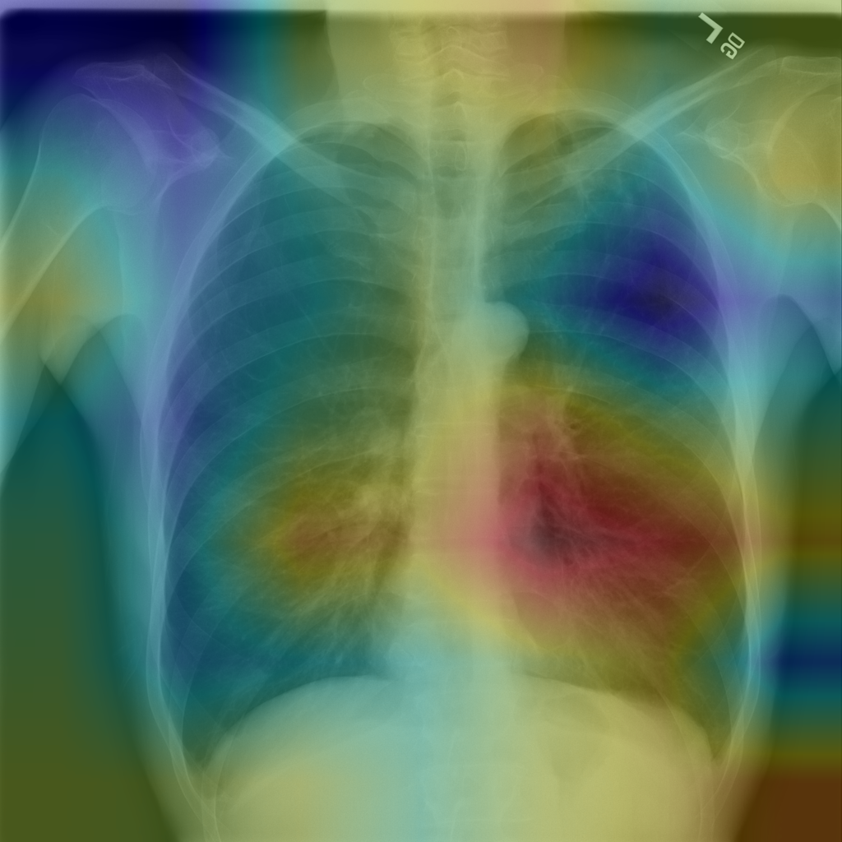
Features of Pneumonia Disease :

Slide 9
Related Works :
No | Paper Name | Data Set Size | Epoch | Accuracy
1 | Detecting Pneumonia in Chest X-Rays with Supervised Learning | 1,12,120 Images | 70 | 0.60 or 60%
2 | CheXNet: Radiologist-Level Pneumonia Detection on Chest X-Rays with Deep Learning | 112,120 Images | 121 Layers with 50 epochs (14 Diseases) | 0.633 or 63% in Pneumonia
3 | Comparison of Deep Learning Approaches for Multi-Label Chest X-Ray Classification | 494 Images split in 2 dataset | 20 | 0.56 or 56%
Detecting Pneumonia in Chest X-Rays with Supervised Learning Benjamin Antin, Joshua Kravitz, and Emil Martayan. https://pdfs.semanticscholar.org/bbc7/49a5c9139dc642a78647c1dfed1df71bba07.pdf
CheXNet: Radiologist-Level Pneumonia Detection on Chest X-Rays with Deep Learning Pranav Rajpurkar, Jeremy Irvin, Kaylie Zhu, Brandon Yang, Hershel Mehta, Tony Duan, Daisy Ding, Aarti Bagul, Robyn L. Ball,
Curtis Langlotz, Katie Shpanskaya, Matthew P. Lungren, Andrew Y. Ng
3. Comparison of Deep Learning Approaches for Multi-Label Chest X-Ray Classification Ivo M. Baltruschat, Hannes Nickisch, Michael Grass, Tobias Knopp & Axel Saalbach.

Slide 10
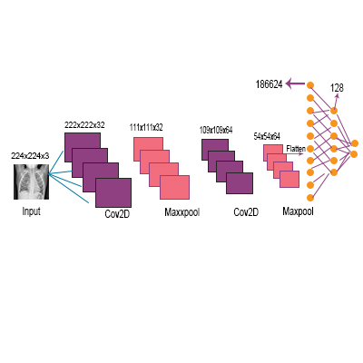
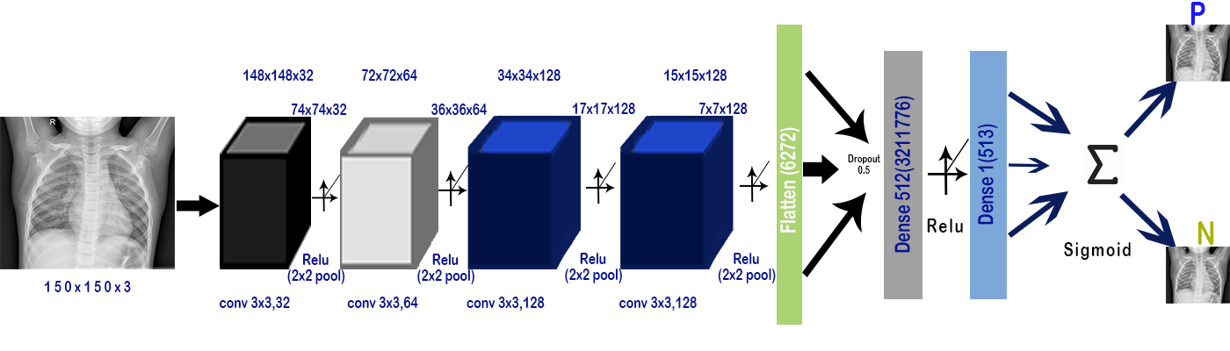
Model Selection:
Model 1
Model 2

Slide 11
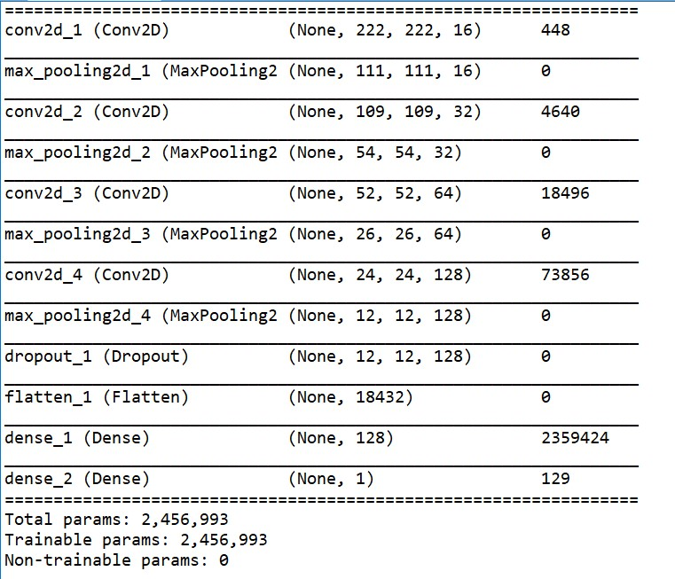
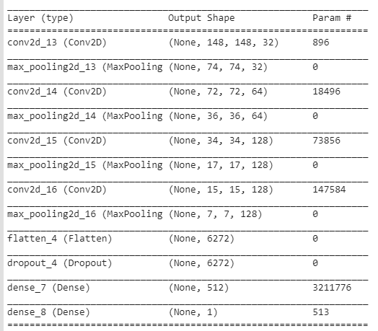
Model Summary
Model 1
Model 2

Slide 12
Experimental Analysis1
Data Set :
Class | Number of Training Images | Number of Testing Images
Pneumonia | 3330 | 560
Normal | 770 | 540
Total | 4100 | 1100

Slide 13
2. Platforms :
Tools Required
1. NumPy
2. Matplotlib
3. Scikit-learn
4. Keras
5. TensorFlow
Operating System
1. Ubuntu
IDE
1. Spyder
2. Jupiter Note Book
3. Google Co-Lab
Configuration Item | Value
Machine Name | ASUS Vivo-Book S15 S531FL
CPU | Intel® Core™ i7-8565U Processor
Clock Speed | 1.8 GHz up to 4.6 GHz
Graphics processor units | NVIDIA GeForce MX250 GDDR5 2GB
Memory | 8GB DDR5
Cache Memory | 8MB
Hard disk | SATA 1TB 5400RPM 2.5' HDD + PCIEG3x2 NVME 256GB M.2 SSD

Slide 14
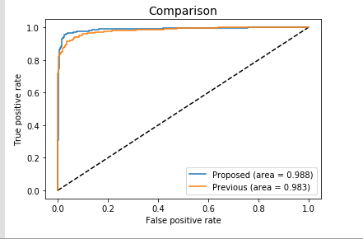
3. Selected Model
Combined ROC Curve of model 1 and 2
Here, 2 models provide almost similar AUC but Model - 2 has less parameters() than model - 1.
So we have chosen this model and the rest of the experiments are performed using this model

Slide 15
4. Model Validation
We have applied and developed two models. Model 2 gave us the best result.
We applied
100 by 100 image shape in input,
150 by 150 image shape in input,
200 by 200 image shape in input,
250 by 250 image shape in input,
300 by 300 image shape in input in our proposed model.
But there were no noticeable difference in loss, accuracy, precision, recall, f1-score. Also in ROC curve.

Slide 16
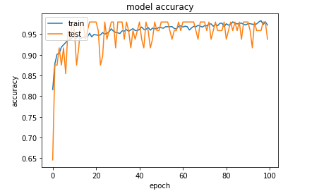
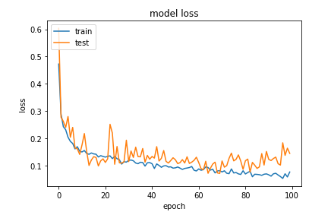
For 100 * 100

Slide 17

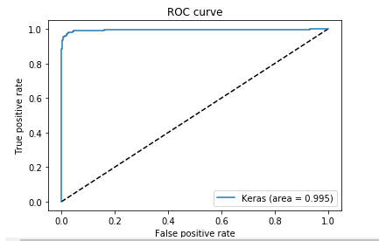
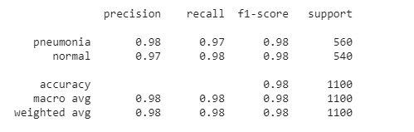
For 100 * 100

Slide 18
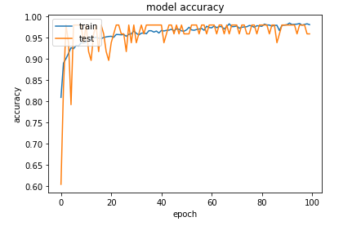
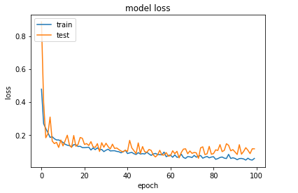
For 150 * 150

Slide 19

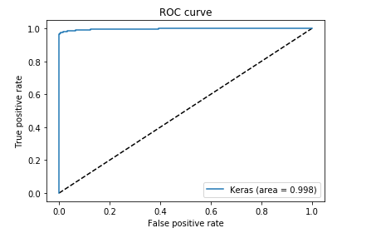
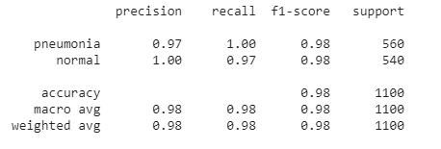
For 150 * 150

Slide 20
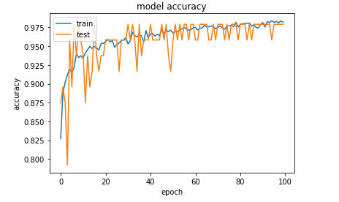
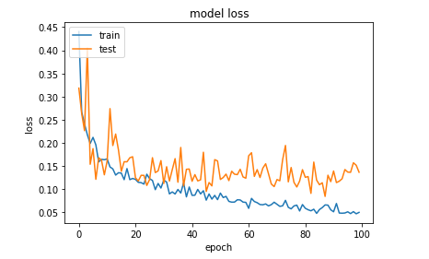
For 200 * 200

Slide 21

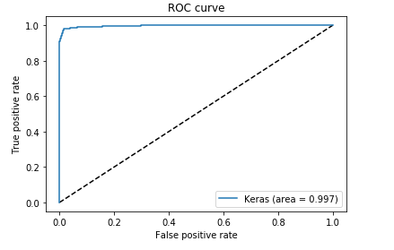
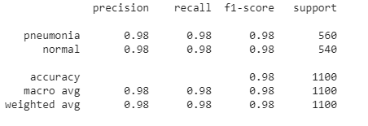
For 200 * 200

Slide 22
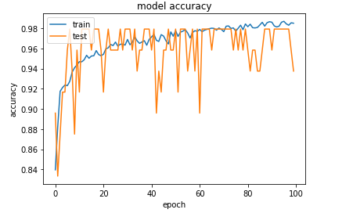
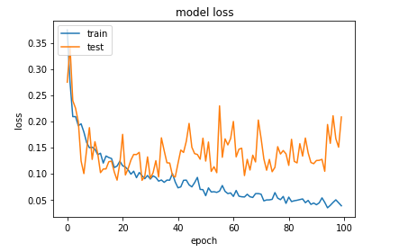
For 250 * 250

Slide 23

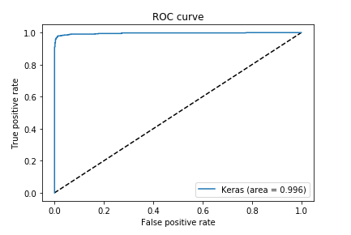
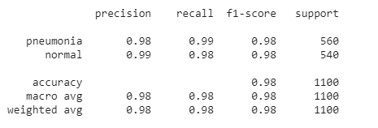
For 250 * 250

Slide 24
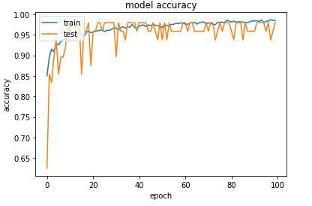
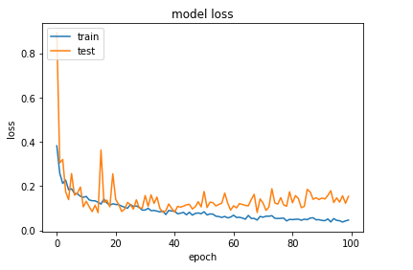
For 300 * 300

Slide 25

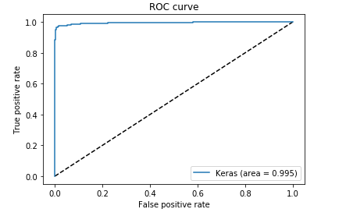
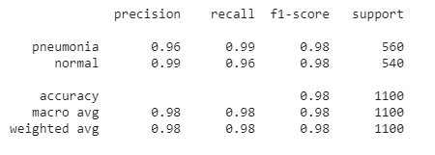
For 300 * 300

Slide 26
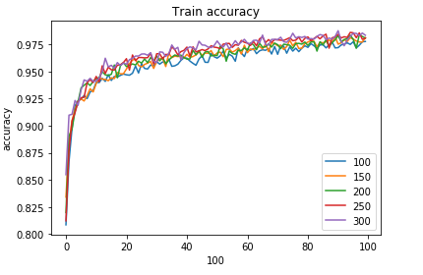
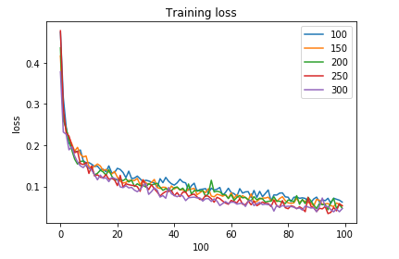
Comparison : In Training Data

Slide 27
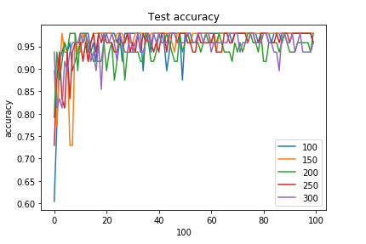
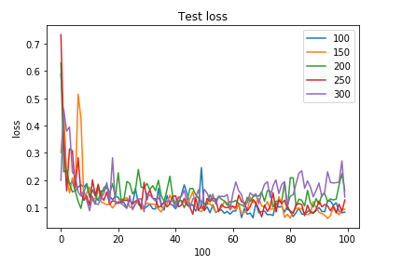
Comparison : In Test Data

Slide 28
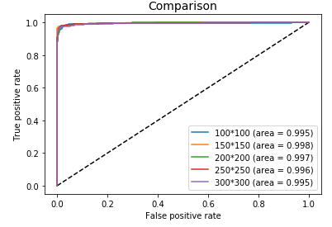
Comparison : ROC

Slide 29
We chose150 by 150 as it shows the best accuracy among all

Slide 30
Confusion Matrix(150x150)
True Positive: 522 | False-Positive: 0
False-Negative: 18 | True-Negative: 560

Slide 31
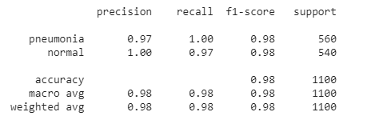
Precision, Recall and F1-score(150x150)

Slide 32
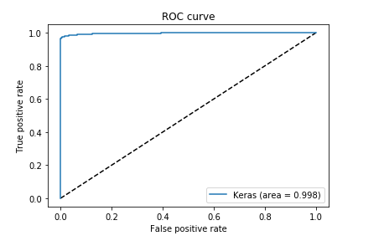
ROC curve(150x150) :

Slide 33
Future Work
Our plan is to collect a larger dataset consisting chest X-ray of patients and normal people from different parts of our country and test our model on it.
As now a days people are more comfortable with mobile devices, we are planning to build a mobile application which will be easily accessible to them.
We want to compare our model with existing models to evaluate and validate it’s effectiveness.

Slide 34
Questions

Slide 35
Thank You

